Slide 1
Observation tower Hard

Slide 2
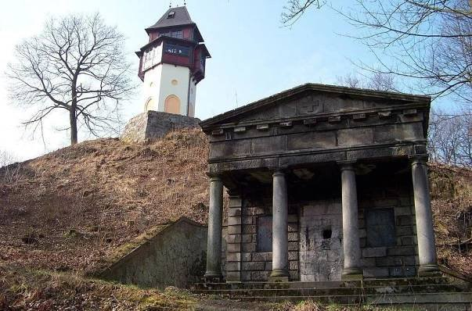
Observation tower Hard
Observation tower Hard is located at Hornická street, just above the hospital directly in the city of Sokolov. The lookout tower is at an altitude of 461 m. The lookout tower is accessible all year round. Hard is the modern name for the Hartberg hill.

Slide 3
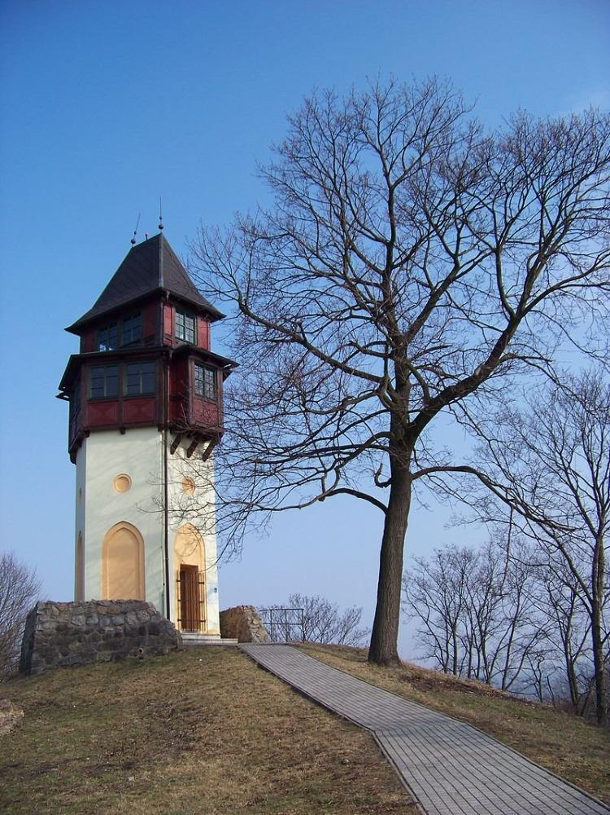
HISTORY
In the years 1908-1933, a wooden observation tower stood on the site height 18 m. Then a monument to the victims of the First World War on the spot.
The observation tower was built in 2001 on the site of the dilapidated memorial to the victims of the First World War and even older observation deck, known as the Dust tower.
The observation tower is a replica from the original tower from 1908.

Slide 4
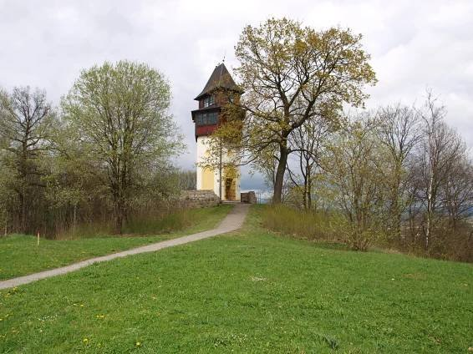
OBSERVATION TOWER TODAY
The observation tower was ceremonially opened on 26 April 2001 at the place where the lookout had previously stood. Today’s observation tower is about 4 m lower than the original one from which it differs only in small details.
Today, the observation tower is 14.5 meters high.
The observation tower has a viewing platform at
a height of 12 m. 55 steps will take you to the top.

Slide 5
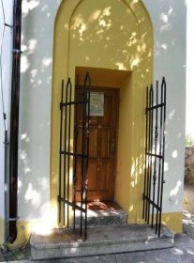
ACCESS
Visitors can reach the observation tower from the center of Sokolov on foot,
by bike, car, and public transport. There is also the possibility of parking.
The observation tower is locked and keys can be borrowed from the local police station.

Slide 6
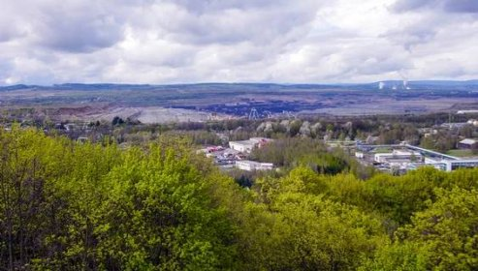
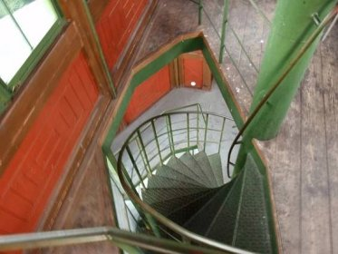
VIEW
The view is circular from two glass floors.
Unfortunately, the view from the observation tower is partially limited by mature trees.
You can see part of Sokolov, in the northern direction of the Ore mountains.
Hard Hill is located about
a kilometer away
from the Sokol castle,
and so it would be a shame to not combine the visit with his tour.

Slide 7
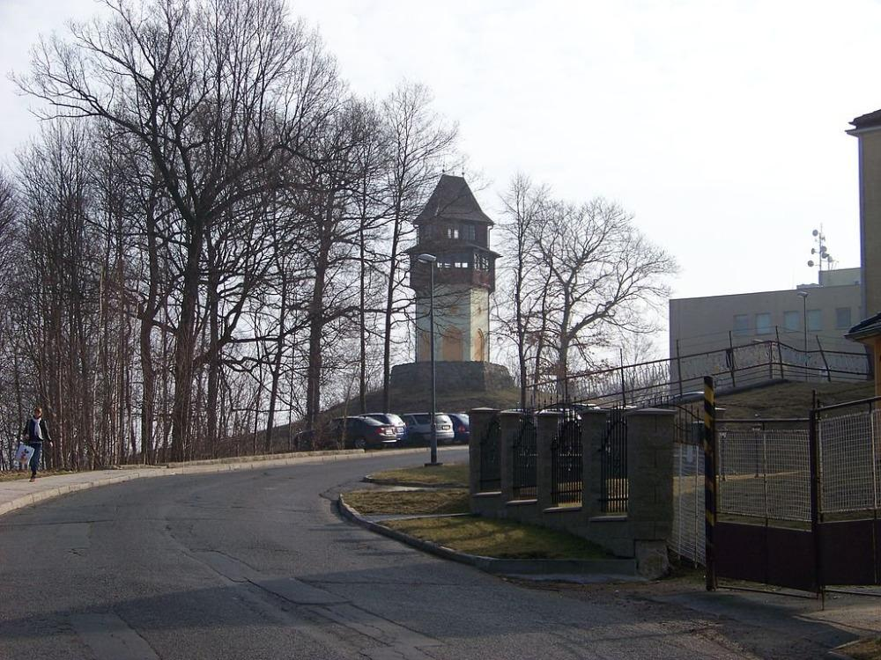
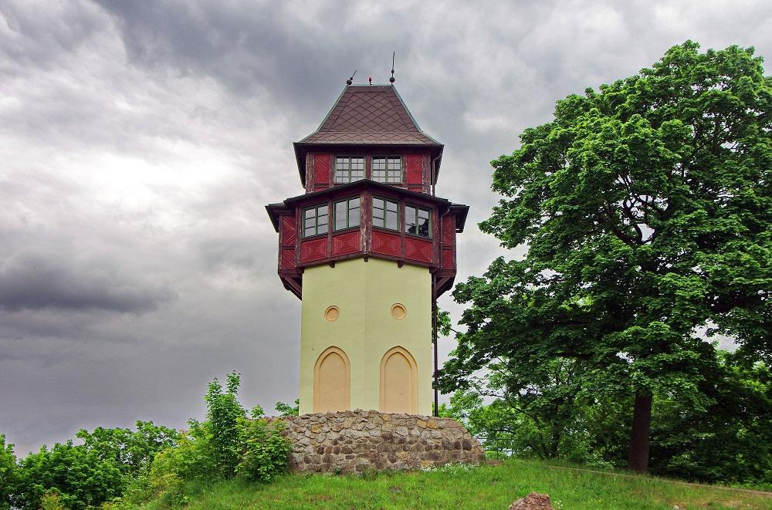
Thank you for your attention
Václav Tomášek

